Slide 1


Customer Shopping Behavior Analysis
Author: Devvrat Tiwari
Role: Data Analytics Student
Email: devvrattiwari2005@gmail.com
Tools Used: Python (Pandas), PostgreSQL, Jupyter Notebook, Power BI
Notes:
1

Slide 2

Project Overview
This project delves into customer shopping behavior, leveraging a dataset of 3,900 transaction records across a diverse range of product categories. Our primary objective is to extract meaningful insights that will drive informed, data-driven business decisions. We aim to understand critical aspects such as spending habits, effective customer segmentation, individual product preferences, and the underlying patterns in subscription models.
Notes:
2

Slide 3
Objectives of the Project
1
2
3
Understand Purchase Patterns
Analyze Customer Segments
Compare Subscriber Behavior
Uncover recurring behaviors and trends in how customers make purchases.
Categorize customers based on their shopping habits and demographics.
Differentiate spending and engagement between subscribers and non-subscribers.
4
5
6
Identify Top Products & Discount Dependency
Analyze Revenue Trends
Build Interactive Dashboard
Examine revenue generation across different demographic groups.
Create a dynamic Power BI dashboard for real-time insights.
Pinpoint best-selling items and evaluate the impact of discounts on sales.
7
Provide Actionable Recommendations
Formulate clear, implementable strategies for business growth.
Notes:
3

Slide 4

Dataset Summary
Comprehensive Data
The dataset comprises 3,900 rows and 18 columns, providing a rich source for analysis.
Key Data Points
Customer demographics
Detailed purchase information
Behavioral features and interactions
Missing Data
Only 37 rating values were identified as missing, indicating high data quality.
Data Quality & Consistency
The dataset exhibits strong data quality and consistency, requiring minimal initial cleanup.
Notes:
4

Slide 5

Exploratory Data Analysis (Python)
01
Data Loading & Initial Exploration
Utilized Pandas for efficient data import and preliminary inspection to understand structure.
02
Missing Data Handling
Applied median imputation for the 37 missing rating values to maintain data integrity.
03
Column Standardization
Converted all column names to snake_case for consistency and ease of use.
04
Feature Engineering
Created new, insightful columns: age_group for segmentation and purchase_frequency_days for behavioral analysis.
05
Redundant Column Removal
Dropped the promo_code_used column to streamline the dataset.
06
Data Storage
Pushed the cleaned and transformed dataset to PostgreSQL for robust querying and analysis.
Notes:
5

Slide 6










SQL Analysis Highlights
Our analysis leveraged ten targeted SQL queries to extract critical business insights from the cleaned dataset.
Revenue by Gender
High-Spending Discount Users
Analyzed gender-specific spending patterns.
Identified customers who spend significantly while using discounts.
Top 5 Products by Rating
Shipping Type Spend
Determined the highest-rated products based on customer feedback.
Compared spending behavior between standard and express shipping users.
Subscribers vs. Non-Subscribers
Discount-Dependent Products
Contrasted purchasing habits of subscribed and unsubscribed customers.
Uncovered products heavily reliant on discounts for sales.
Customer Segmentation
Top 3 Products per Category
Developed distinct customer segments based on various attributes.
Identified leading products within each defined category.
Repeat Buyers & Subscriptions
Revenue by Age Group
Analyzed patterns of repeat purchases and subscription engagement.
Examined how revenue varies across different age demographics.
Notes:
6

Slide 7
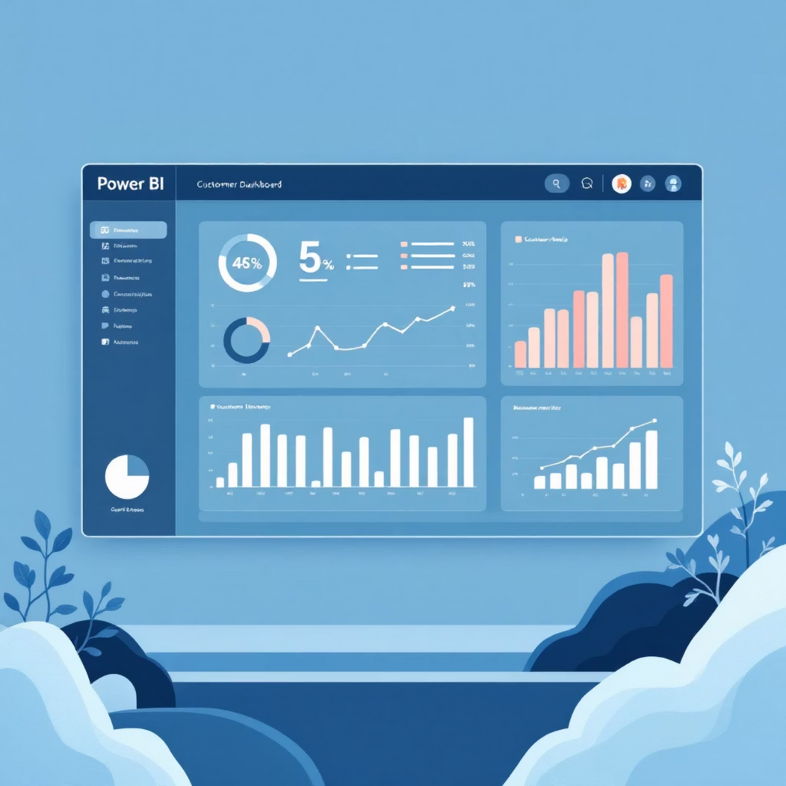
Power BI Dashboard Overview
The interactive Power BI dashboard provides stakeholders with quick, actionable insights for decision-making. It consolidates key metrics and visualizations, allowing for dynamic exploration of customer shopping behavior.
KPIs: Total Revenue, Average Spend per Customer
Revenue Breakdown: By Age, Gender, and Subscription Status
Customer Segmentation: Visual representation of different customer groups
Ratings Analysis: Overview of product ratings and customer satisfaction
Category Performance: Insights into how various product categories are performing
Discount Impact: Analysis of how discounts influence purchasing decisions
Shipping Type Analysis: Comparison of spending habits based on shipping preferences
Notes:
7

Slide 8




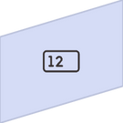

Key Insights
Top-Performing Products & Demographics
Identified specific products that resonate most strongly with particular demographic groups.
High Discount Usage Patterns
Observed significant reliance on discounts, particularly among certain customer segments, influencing purchasing decisions.
Loyal vs. New Customers
Distinguished between established loyal customers and recent acquisitions, revealing differing spending habits and product preferences.
Express Shipping Users Spending More
Customers opting for express shipping consistently demonstrate higher average transaction values.
Age Groups Driving Revenue
Pinpointed specific age demographics that contribute the highest proportion of overall revenue.
Subscribers Generate Higher Spend
Customers with subscriptions exhibit a notably higher average spend compared to non-subscribers.
Notes:
8

Slide 9
Business Recommendations
1
Boost Subscription Benefits
Enhance exclusive perks and value propositions for subscribers to increase retention and attract new sign-ups.
2
Strengthen Loyalty Programs
Develop and promote robust loyalty programs to reward repeat buyers and foster long-term customer relationships.
3
Review Discount Strategy
Optimize discount allocation to improve profit margins without deterring sales, focusing on strategic product promotion.
4
Promote Top-Rated Products
Highlight and market best-selling, highly-rated products more aggressively to capitalize on existing customer satisfaction.
5
Target High-Value Segments
Tailor marketing campaigns specifically for high-spending age groups and loyal customer segments for maximum impact.
6
Personalized Strategies for Repeat Buyers
Implement customized recommendations and offers for repeat buyers to encourage continued engagement and increase lifetime value.
Notes:
9

Slide 10

Thank You
For further insights or discussions, please contact:
Devvrat Tiwari
devvrattiwari2005@gmail.com
Notes:
10

